Slide 2
Torment Your Colleagues with the “Roslyn” .NET Compiler Platform
Ivan Towlson
M385

Slide 3
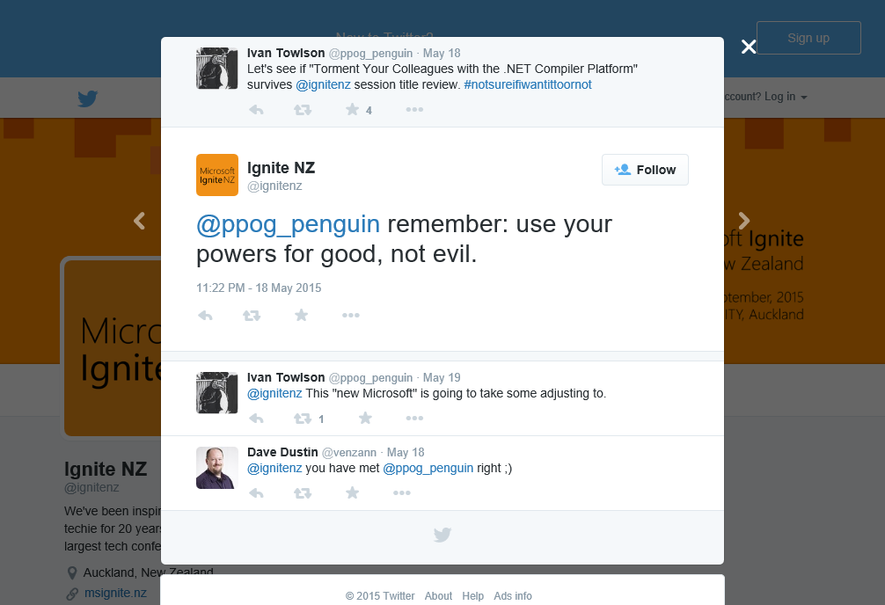

Slide 4
Subject Your Colleagues to Your Bureaucratic Tyranny with the “Roslyn” .NET Compiler Platform
Ivan Towlson
M385

Slide 5
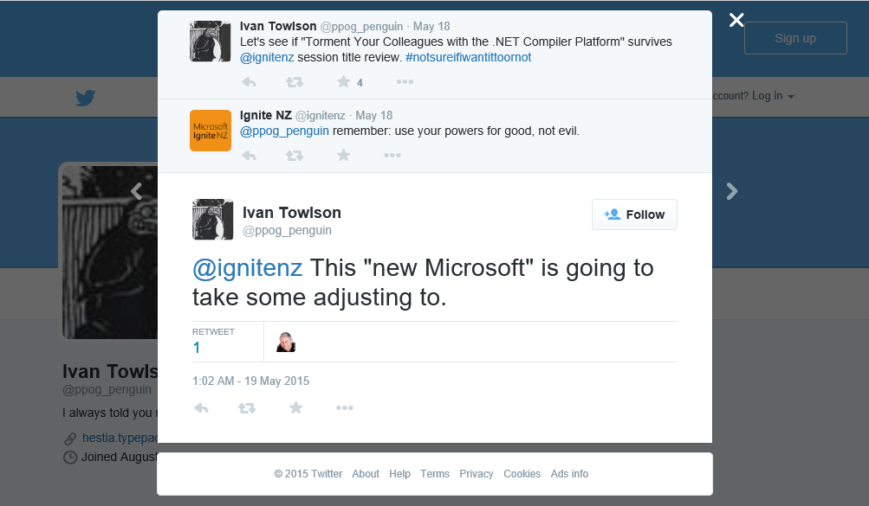

Slide 6
Make Your Colleagues Even More Awesome with the “Roslyn” .NET Compiler Platform
Ivan Towlson
M385

Slide 7
What is Roslyn?
“The Duke Nukem Forever of compilers”
https://twitter.com/jbogard/status/623150768728637445
Key milestones
1842 Roslyn project founded by Ada Lovelace
1895 Roslyn team announces plans to re-target to Hollerith tabulating machine
1936 Alan Turing proves Halting Problem “will Roslyn project ever halt?” undecidable
1958 Acrimonious split leads to Roslyn forking into Lisp and ALGOL
1975 Bill Gates reads about Altair 8800, founds “Micro-Soft” to port Roslyn for it
2015 Roslyn ships

Slide 8
What is Roslyn?
C# and Visual Basic compilers
Syntax trees for code
…even invalid code!
Semantic model
Visual Studio editor integration
But you don’t have to be in Visual Studio to use Roslyn

Slide 9
What is Roslyn?
Not just a compiler, but a platform
Static analysis
Fixing coding errors
Refactoring
Style guides
Code generation / preprocessing
Scripting / REPL
Code metrics
Documentation
Lowering the barrier to entry
Making it easier to create your own tools to reflect your own team

Slide 10
What is Roslyn?
Open source
Apache licence
You can fork and modify Roslyn
Raise issues via GitHub
They accept pull requests!

Slide 11
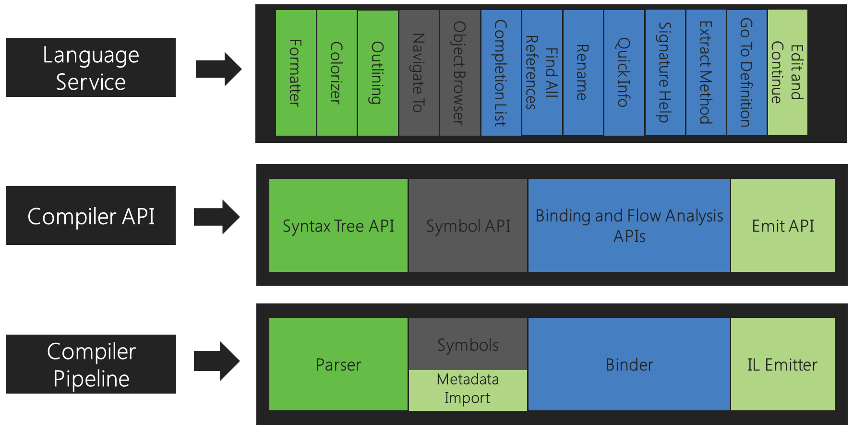
Source: https://github.com/dotnet/roslyn/wiki/Roslyn%20Overview

Slide 12
Source: https://github.com/dotnet/roslyn/wiki/Roslyn%20Overview

Slide 13
Source: https://github.com/dotnet/roslyn/wiki/Roslyn%20Overview

Slide 14
Tools and resources
Roslyn Quoter
http://roslynquoter.azurewebsites.net/
Syntax Visualiser window
View > Other Windows > Syntax Visualiser
Learning resources
https://github.com/dotnet/roslyn/wiki/Roslyn%20Overview
https://github.com/dotnet/roslyn/wiki/Samples-and-Walkthroughs
https://github.com/icsharpcode/RefactoringEssentials
https://joshvarty.wordpress.com/learn-roslyn-now/

Slide 15
Thanks!
Make analysers and fixes part of your workflow
What standards does the team want to stick to?
What ‘when you do X, remember to do Y’ patterns make you anxious?
What repetitive coding errors do you frequently make that the compiler doesn’t catch?
Be pragmatic
Developing analysers and fixes has a cost
Sometimes it’s more cost effective to detect an issue and leave it to be fixed by hand
Iterate – consider what tools to implement as part of retrospectives and code reviews
Use your powers for good
Don’t be too prescriptive
False positives have a cost

Slide 16

Related Ignite NZ Sessions
1
What’s new in Visual Studio 2015
2
Introduction to ASP.NET 5
Find me later at…
The front here
itowlson@microsoft.com
@ppog_penguin
http://hestia.typepad.com/flatlander
http://github.com/itowlson/torment-roslyn

Slide 17





Resources
Microsoft Virtual Academy
TechNet & MSDN Flash
Free Online Learning
http://aka.ms/mva
Subscribe to our fortnightly newsletter
http://aka.ms/technetnz http://aka.ms/msdnnz
Sessions on Demand
http://aka.ms/ch9nz

Slide 18





Complete your session evaluation now and be in to win!

